Slide 1
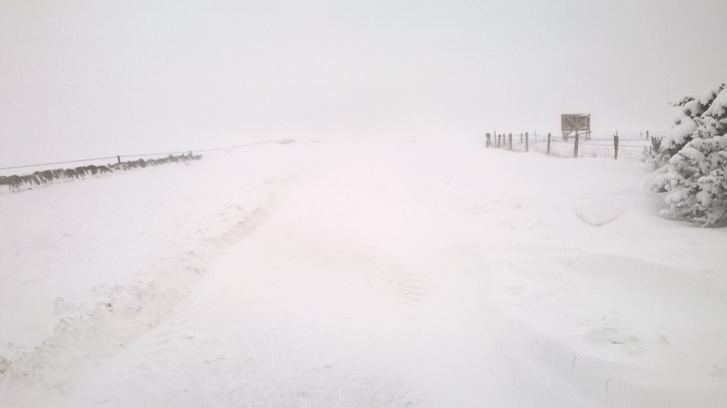
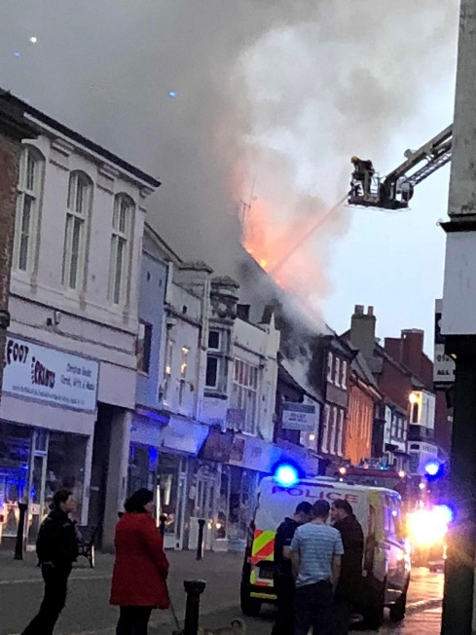
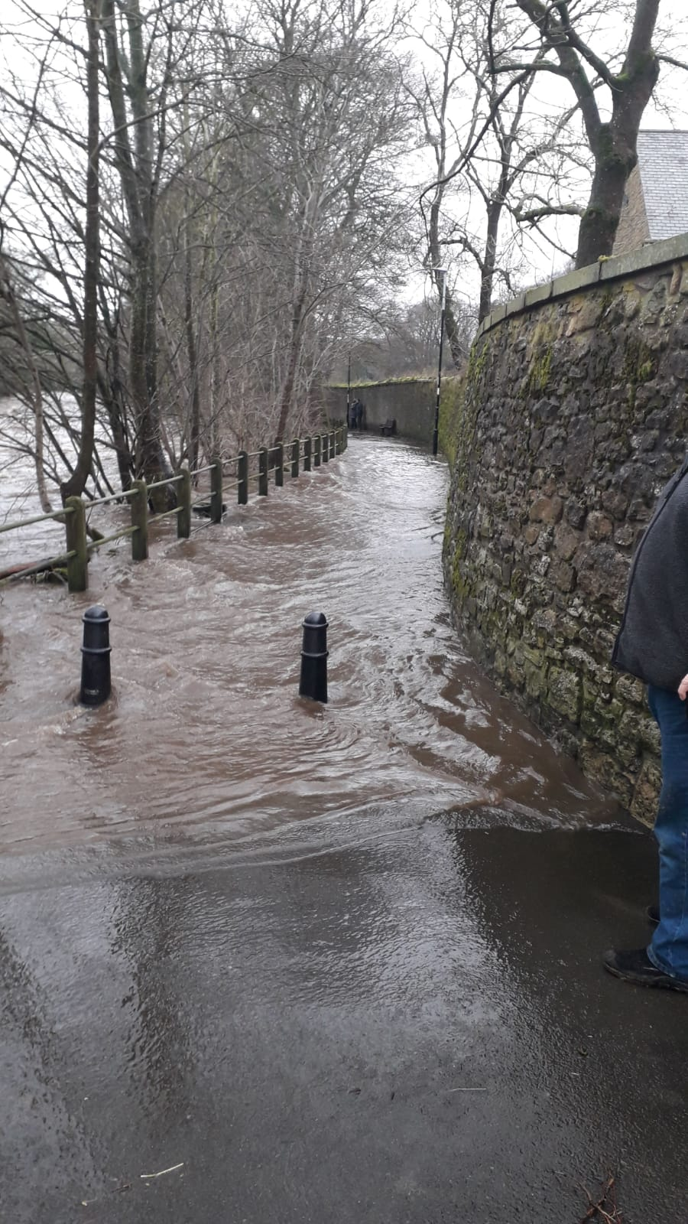
Community Emergency Plans

Slide 2
Laura Dobson
Durham County Council
Civil Contingencies Unit (CCU)
Colin Hall
Environment Agency
Community Engagement Officer

Slide 3
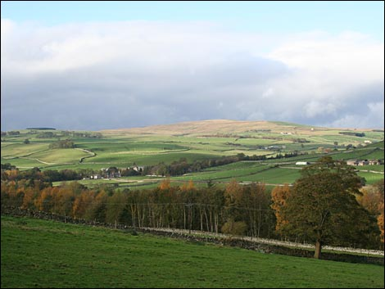
What is Community Resilience?
Communities and individuals using local resources and expertise to help themselves to prepare for and respond to an emergency.
Notes:
“Communities” are groups of people linked by a common bond, e.g. geographical, ‘interests’, ‘circumstance’, ‘supporters’.

Slide 4
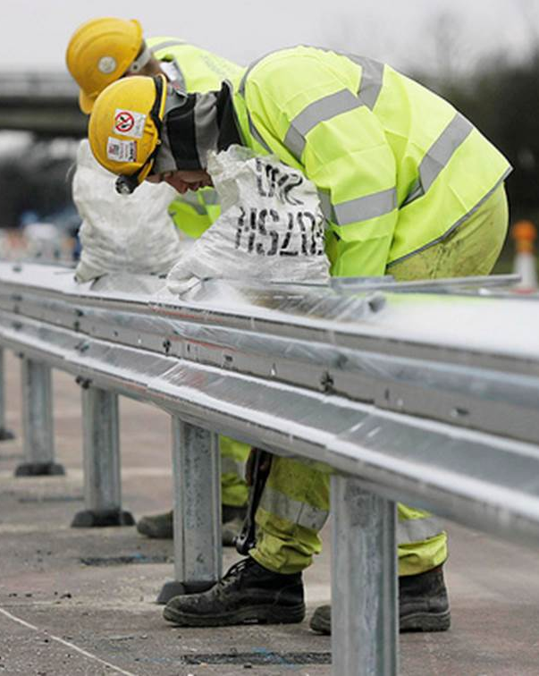
Community Resilience is NOT about:
Doing the work of the emergency services or the Council.
Cuts to services.
Putting yourself or others in danger.

Slide 5
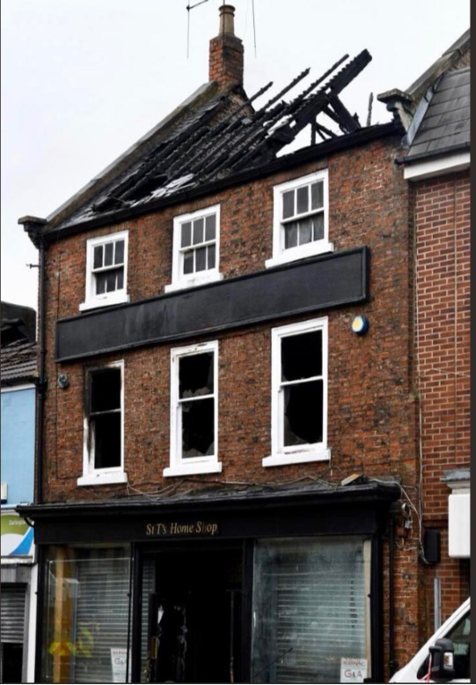
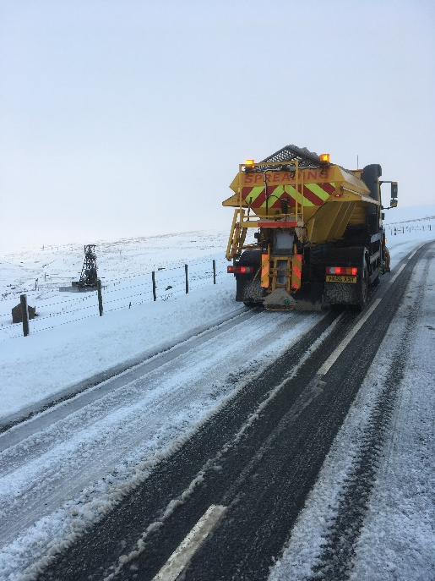
What Are The Risks?
Severe Weather
Flooding
Pandemic Flu
Power cut
Environmental contamination
Landslip
Animal disease
Notes:
Refer to Risk Register – circulate User friendly version of Community Risk Register once published or give link.

Slide 6
It doesn’t have to be a big emergency….
…it could be heavy snow that puts vulnerable people at risk

Slide 7
Why is community resilience important?
You have valuable local knowledge
You can protect you and your family
You can protect your home and belongings
You can help friends and neighbours
You can help your community recover from an emergency

Slide 8
How can you help?
Direct emergency services to specific locations
Advise and warn neighbours (to prepare)
Monitor and support residents
Use your local knowledge to inform plans
Help to protect vulnerable properties
Assist in getting back to normality

Slide 9
What Can a Community Emergency Group Do?
Produce a Community Plan.
Agree in advance who does what, when and from where.
Promote and act.
Liaise with emergency services and Council.
Train and exercise.
Store equipment (e.g. sand bags).

Slide 10
The Plan
Draft template provided
You fill in specific information for your community
Local risks
Local skills and resources
Key locations (places of safety, coordination point)
Contact details

Slide 11
The Roles
A Community Emergency Coordinator
Lead role in the plan.
A Community Emergency Group
Made up of volunteers (normally lead by a Parish Council or sit under a Parish Council).
Other Community Volunteers
To help during an incident.
CCU (Civil Contingencies Unit)
link between Community Emergency Group and responding agencies.

Slide 12
The Process

Slide 14
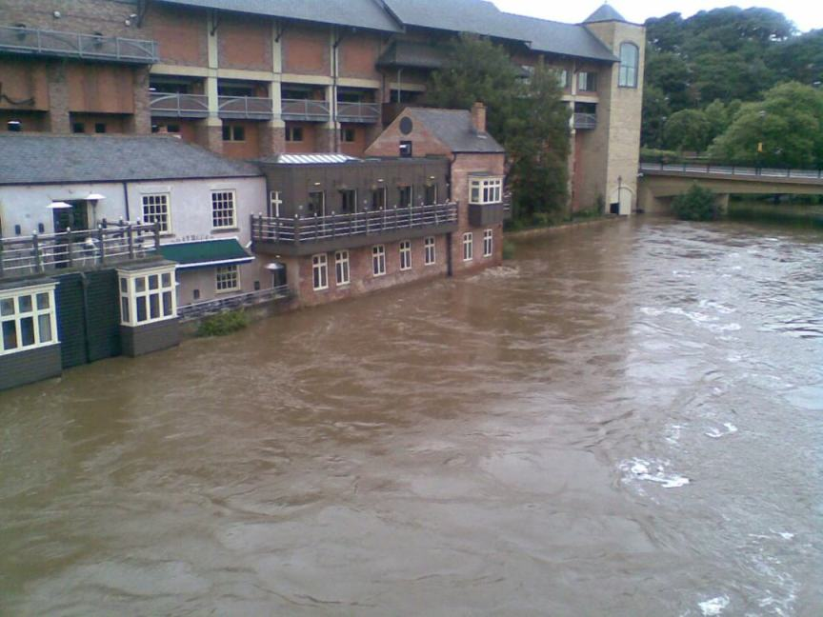
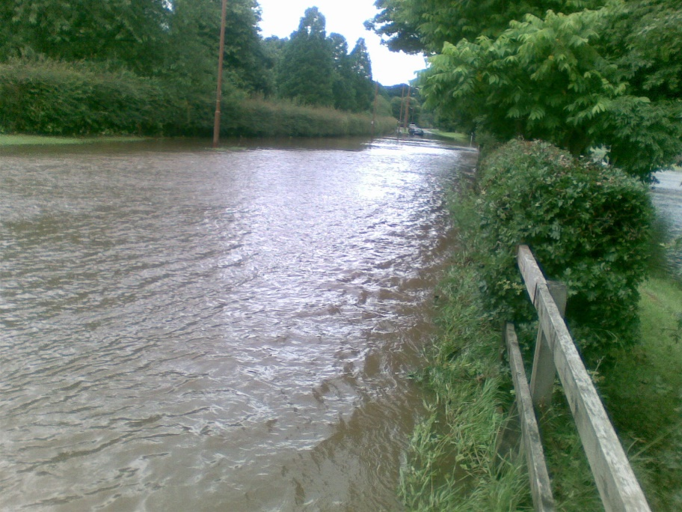
Flooding
One of the countries biggest risks
Coastal, fluvial, surface water and groundwater flooding
Climate change means heavier downpours over shorter time periods
Year round risk

Slide 15
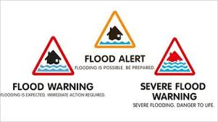
Community Flood Resilience
Sign up to the Flood Warning Service
Create a Community Flood Plan and Flood Group
Advise on Property Level Resilience (PLR)
Personal and Business Flood Plans
Community education

Slide 16
Lanchester Community Emergency Plan
Run by Lanchester Parish Council and volunteers from community

Slide 17
Lanchester Community Emergency Plan
Managed by Lanchester Parish Council
Community emergency group consists of Parish Council and members of the community
Adopted in February 2016:
Following June 2012 Thunder Thursday- over 90 homes and businesses flooded
Following June 2013- multi agency exercise called Operation Valencia

Slide 18
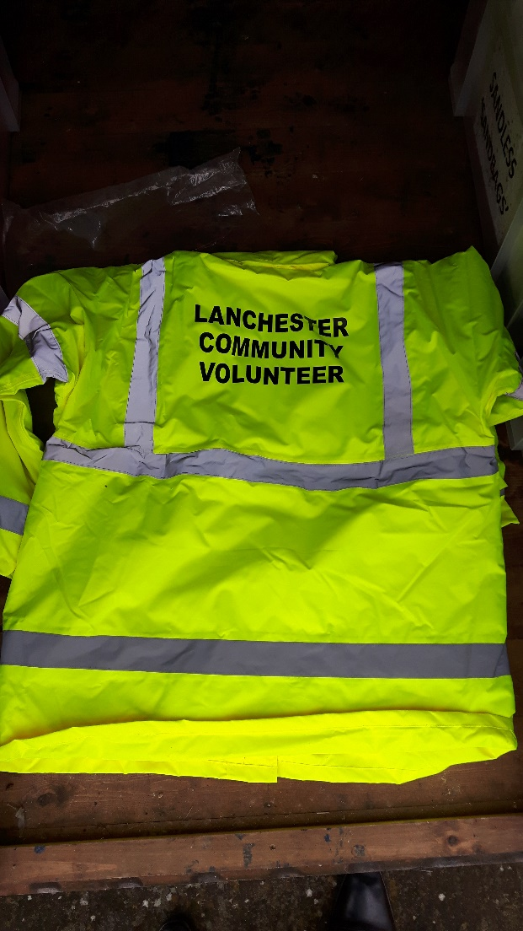
Lanchester Community Emergency Plan
Key elements:
Telephone tree
Equipment sheds
Rest centres
Contact with the CCU and emergency services

Slide 19
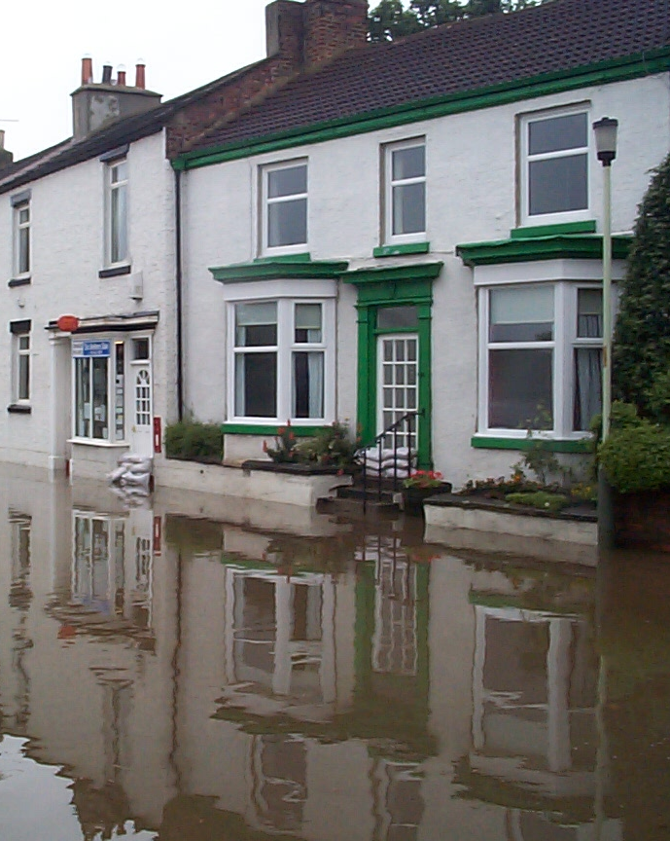
Hurworth Community Resilience
Set up in response to the risk of the River Tees flooding
Run by a network of local residents
Self-supporting organisation
Has developed a trusting working relationship with emergency responders
Notes:
The Group formed after residents were invited to a Parish Council meeting attended by the Environment Agency from Newcastle and The Civil Contingency Unit. The E.A. outlined the importance of local knowledge in dealing with a flood event.
A self help group was formed from residents and volunteers. The E.A. and The Civil Contingency Unit gave guidance and examples of documentation available for initial meetings, where action plans were discussed.
A “flexible “Action Plan(documented 2011) was formulated and responsibilities were outlined.
Two residents coordinate the action on receipt of a flood warning.
When a flood warning is issued wardens - who will have received the automated message - will assemble to take action. One volunteer is designated to liaise with the responding organisations. All these agencies are outlined in the Plan, along with their emergency telephone numbers.

Slide 20
What help is available?
Contact Laura at the Civil Contingencies Unit
Tel: 03000 264638
Email: laura.dobson@durham.gov.uk

Slide 21
Questions?

